Slide 1

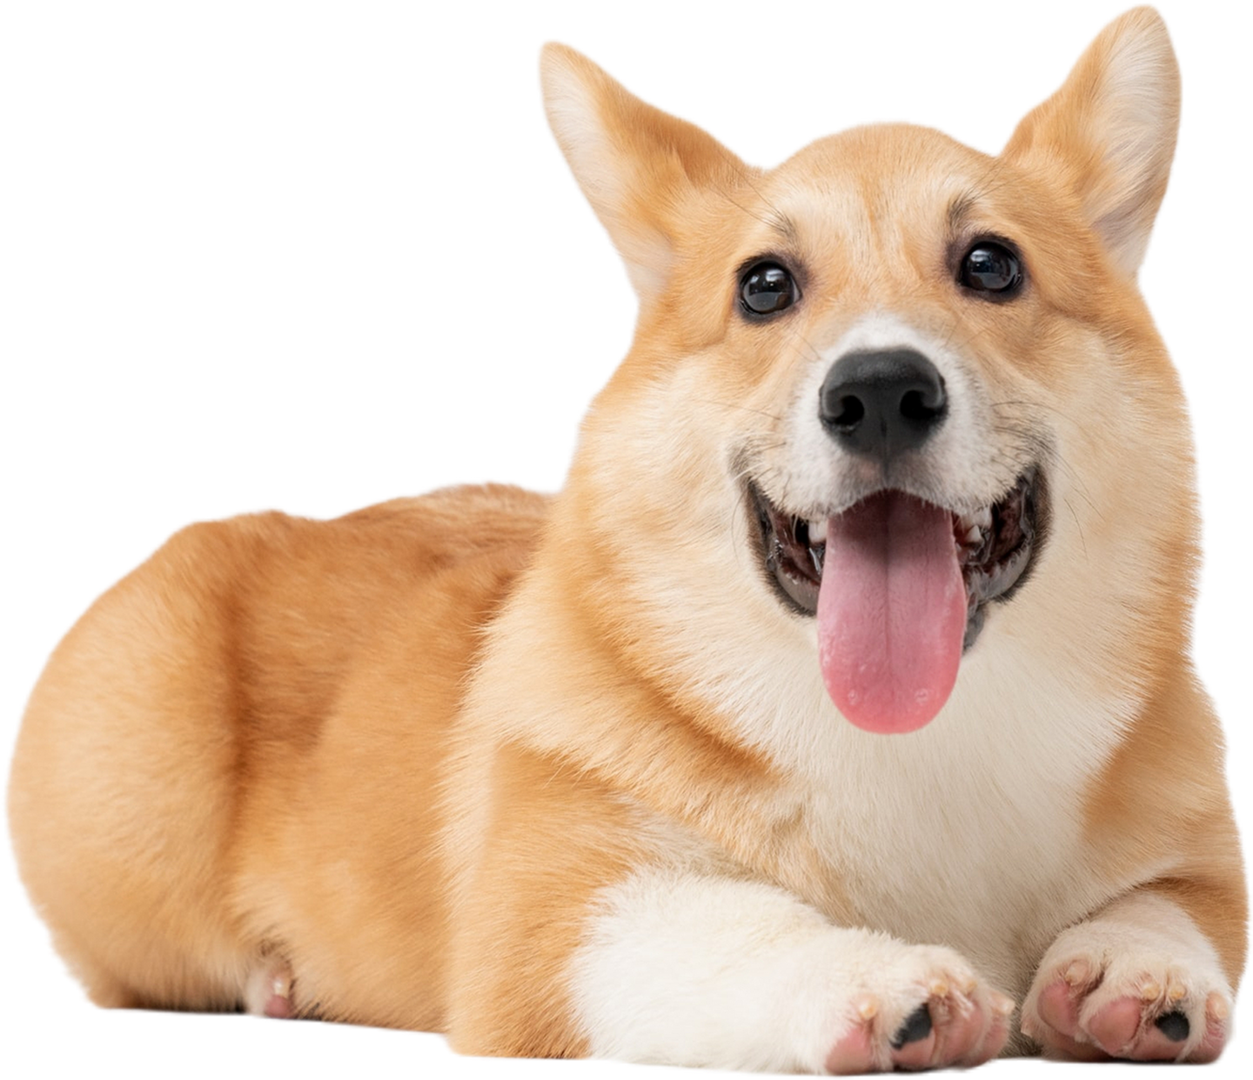






Corey Duncan
Pawsitive
Vibes
Dog Emotion Image Classifier

Slide 2

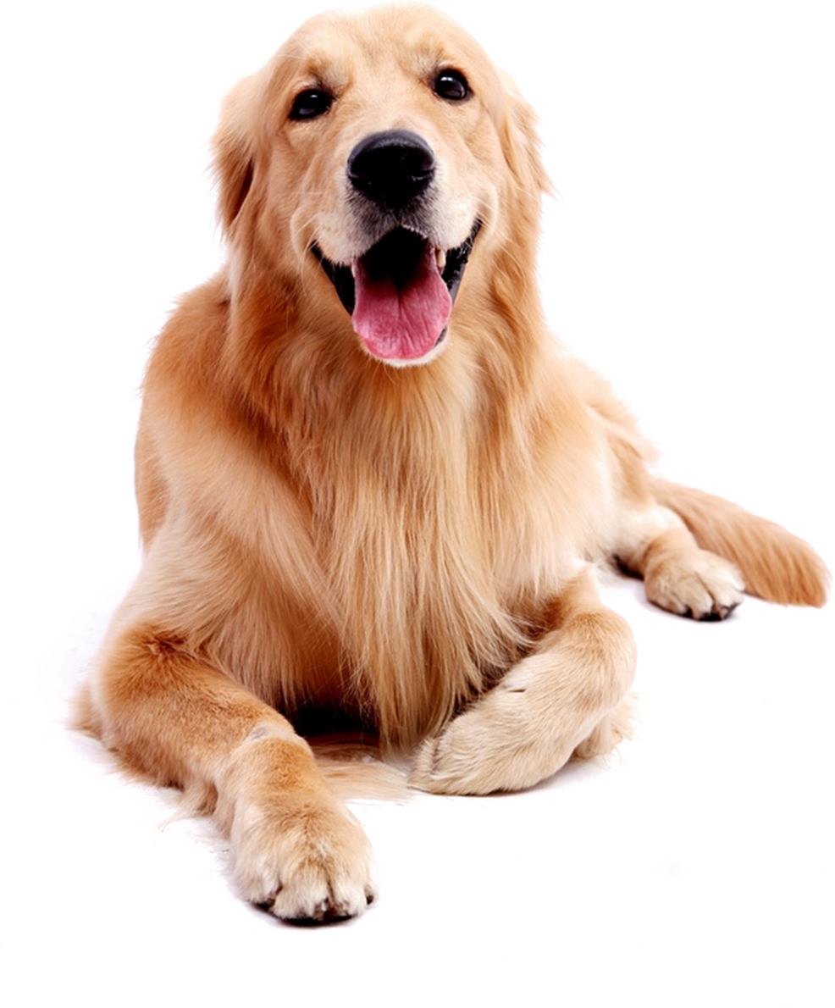

Presentation Outline
1
4
Intro
Models
2
Problem Statement
5
Streamlit App
3
6
Conclusions & Next Steps
EDA

Slide 3



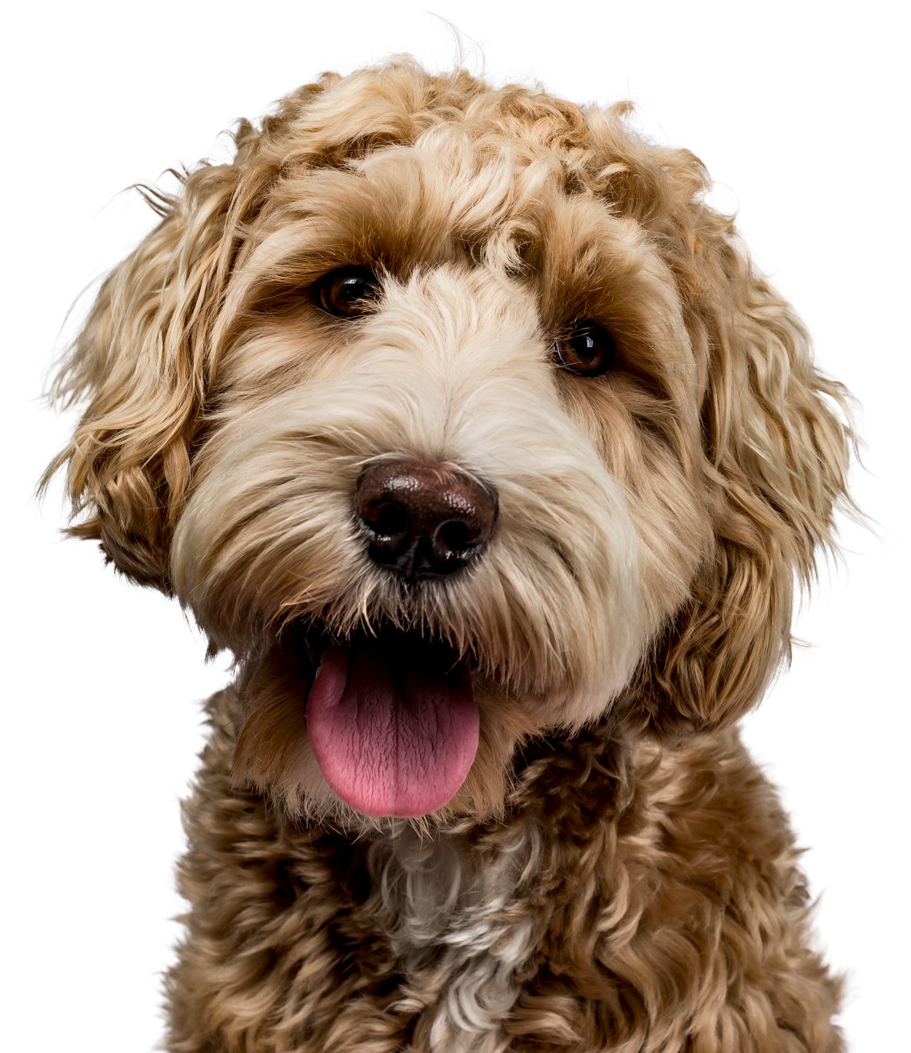

Nearly nothing maintains a larger presence on social media than our pets doing cute or funny things.
The aim of this project is to develop a machine learning model capable of accurately classifying dog emotions. This is intended to support the functionality of social media filters and features that can identify and respond to specific canine emotional states, to increasing user engagement and interaction.
Intro

Slide 4

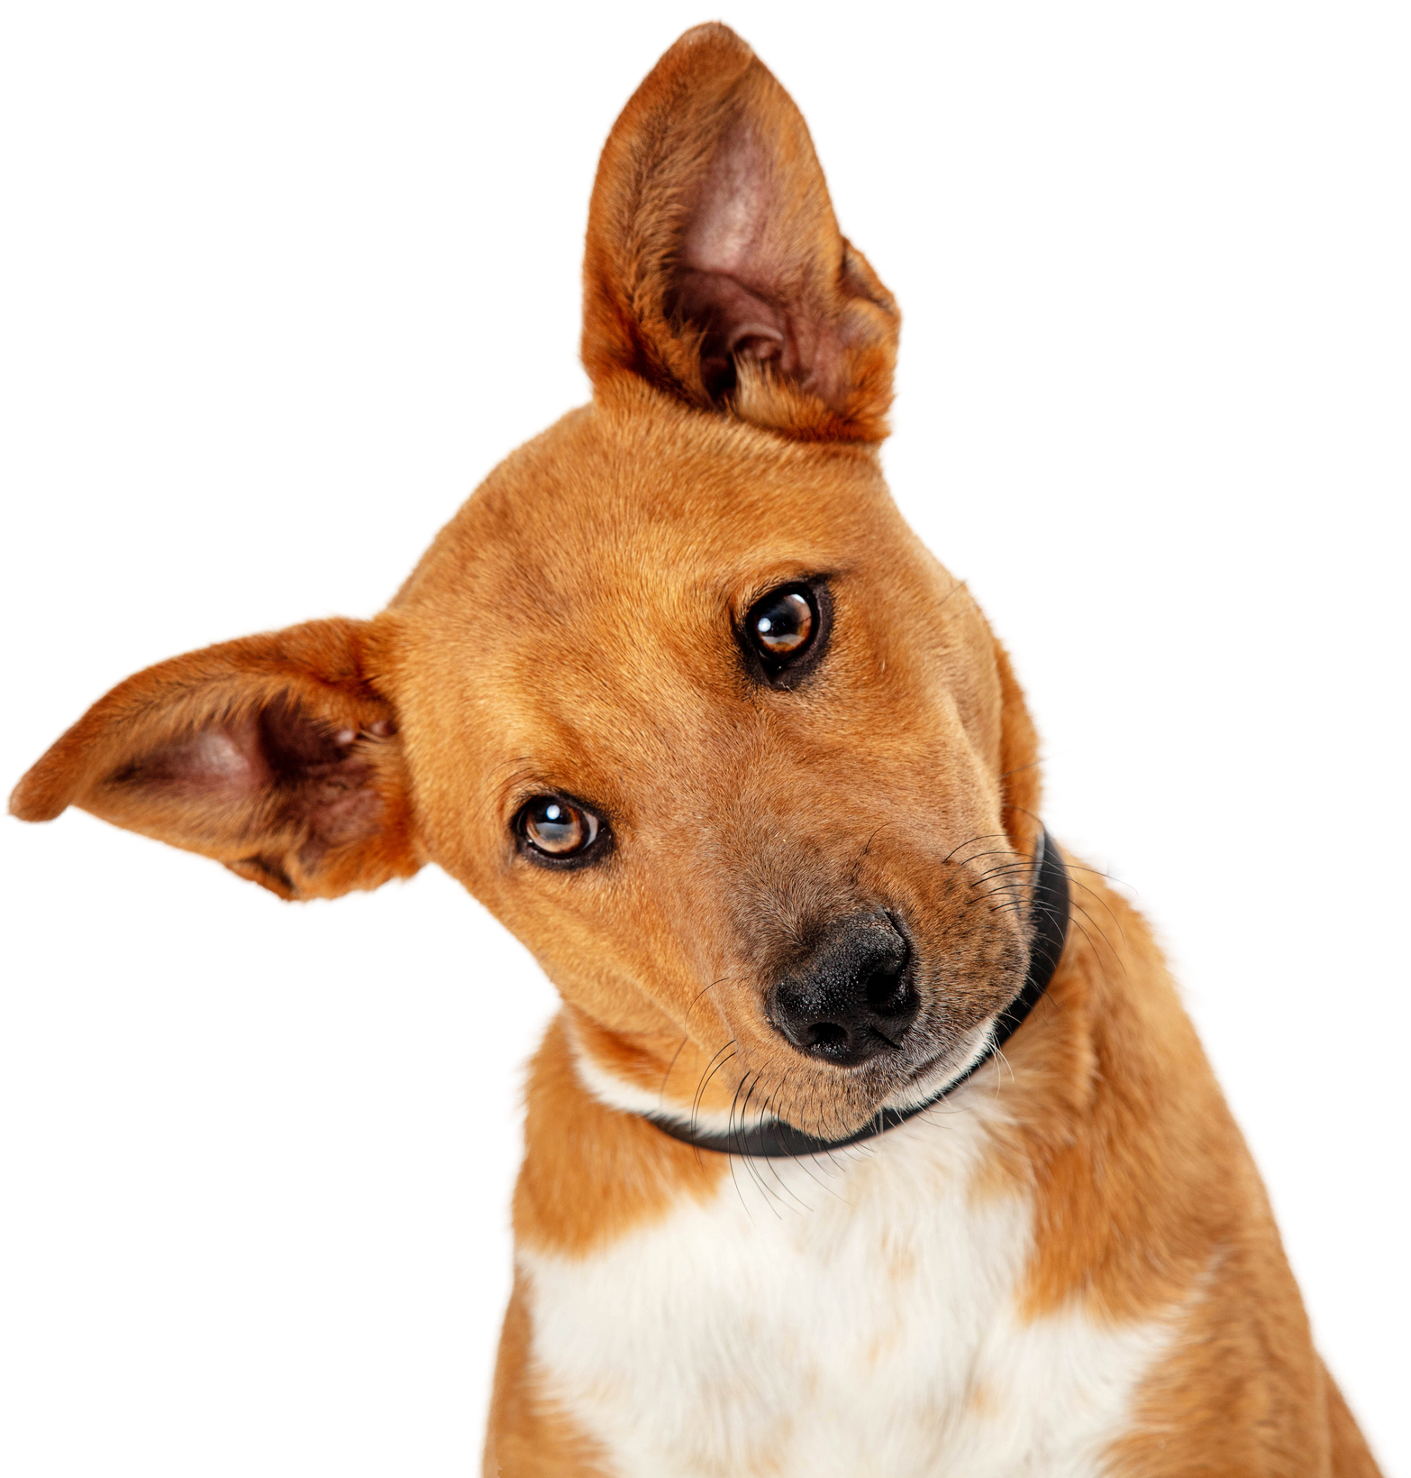

Problem
Statement
Can we build a machine learning model to accurately classify dog emotions from images of dog faces?
Questions
What is our baseline?
How will success be measured?
What type of model yields best results?

Slide 5
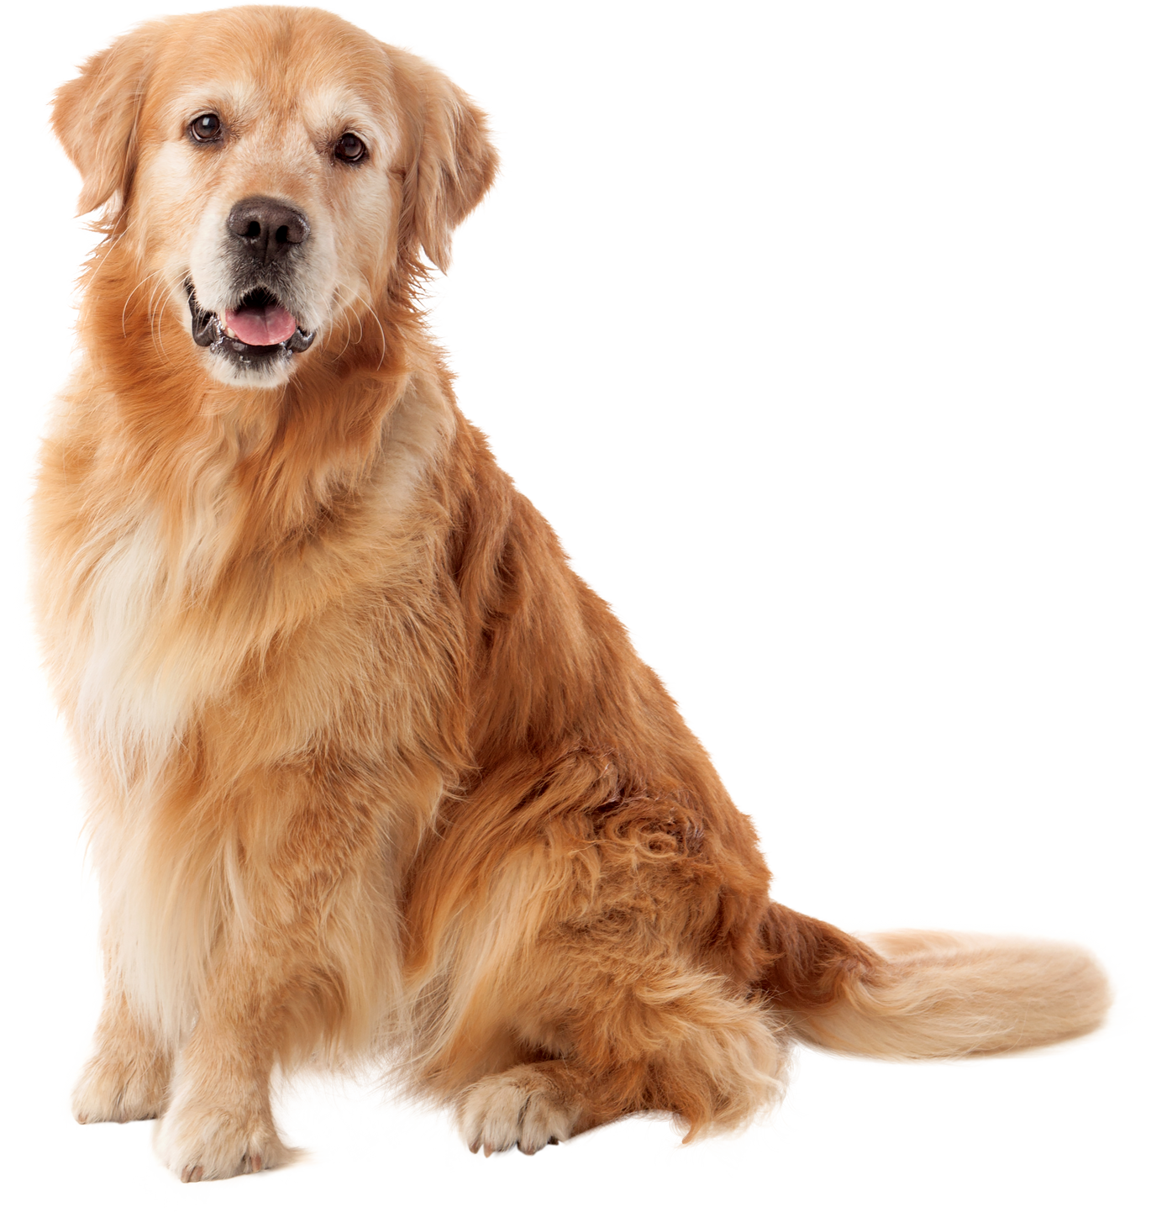
EDA
My dataset consisted of 4000 images, labeled into four classes: Angry, Happy, Sad and Relaxed.
My classes were completely balanced at 1000 images per emotion.
No missing values or erroneous values from my Labels dataset
I discovered only 3 corrupt images belonging to the anger class and removed them.

Slide 6
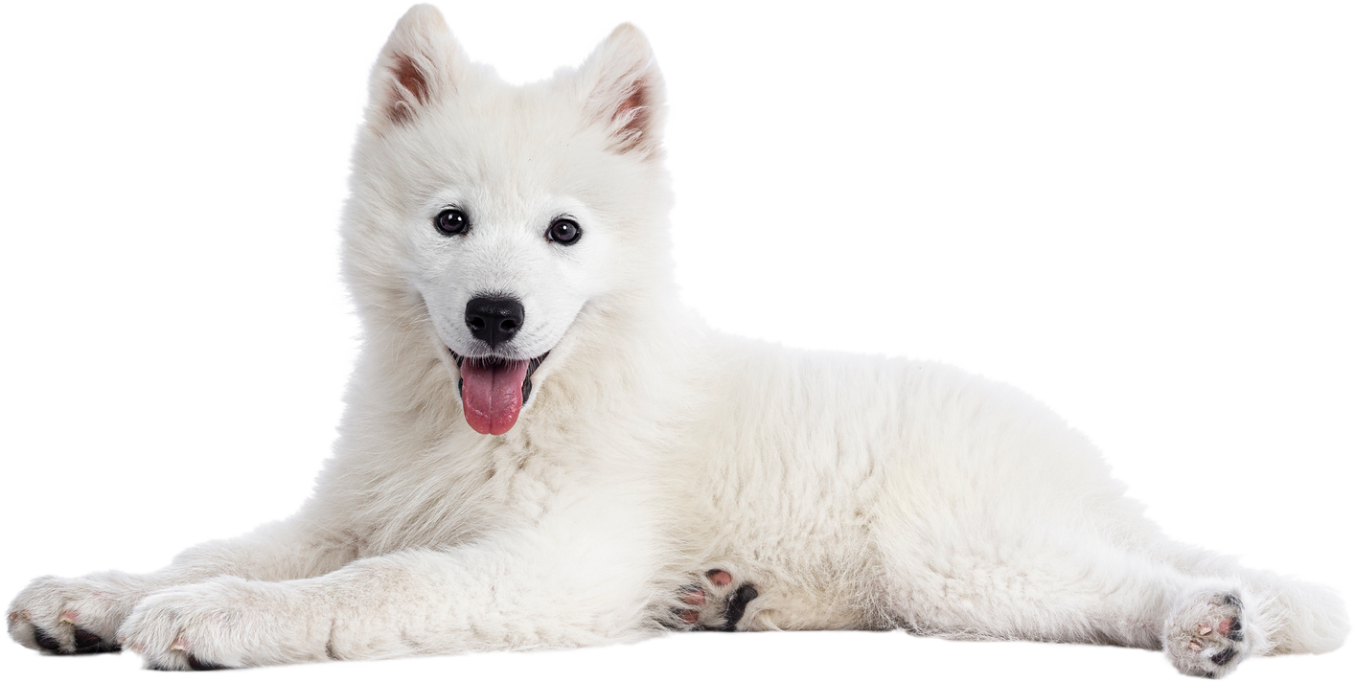


Models
Baseline : 25%
CNN
CNN + Data Aug
VGG16 + L1 & L2
VGG16 + AdamW
7 convolutional layers
Max Pooling
Dropout
Adamax optimizer
7 convolutional layers
Max Pooling
RandomFlip, Rotation & Zoom
Adamax optimizer
Input Shape 224 x 224
Global Average Pooling
No Dropout
Adamax optimizer
Input Shape 224 x 224
Global Average Pooling
No Dropout
AdamW optimizer
Weight Decay = 0.01
Acc : 42%
Acc : 58%
Acc : 61%
Acc : 65%
*All of these models experienced severe overfitting after achieving these accuracy scores.

Slide 7
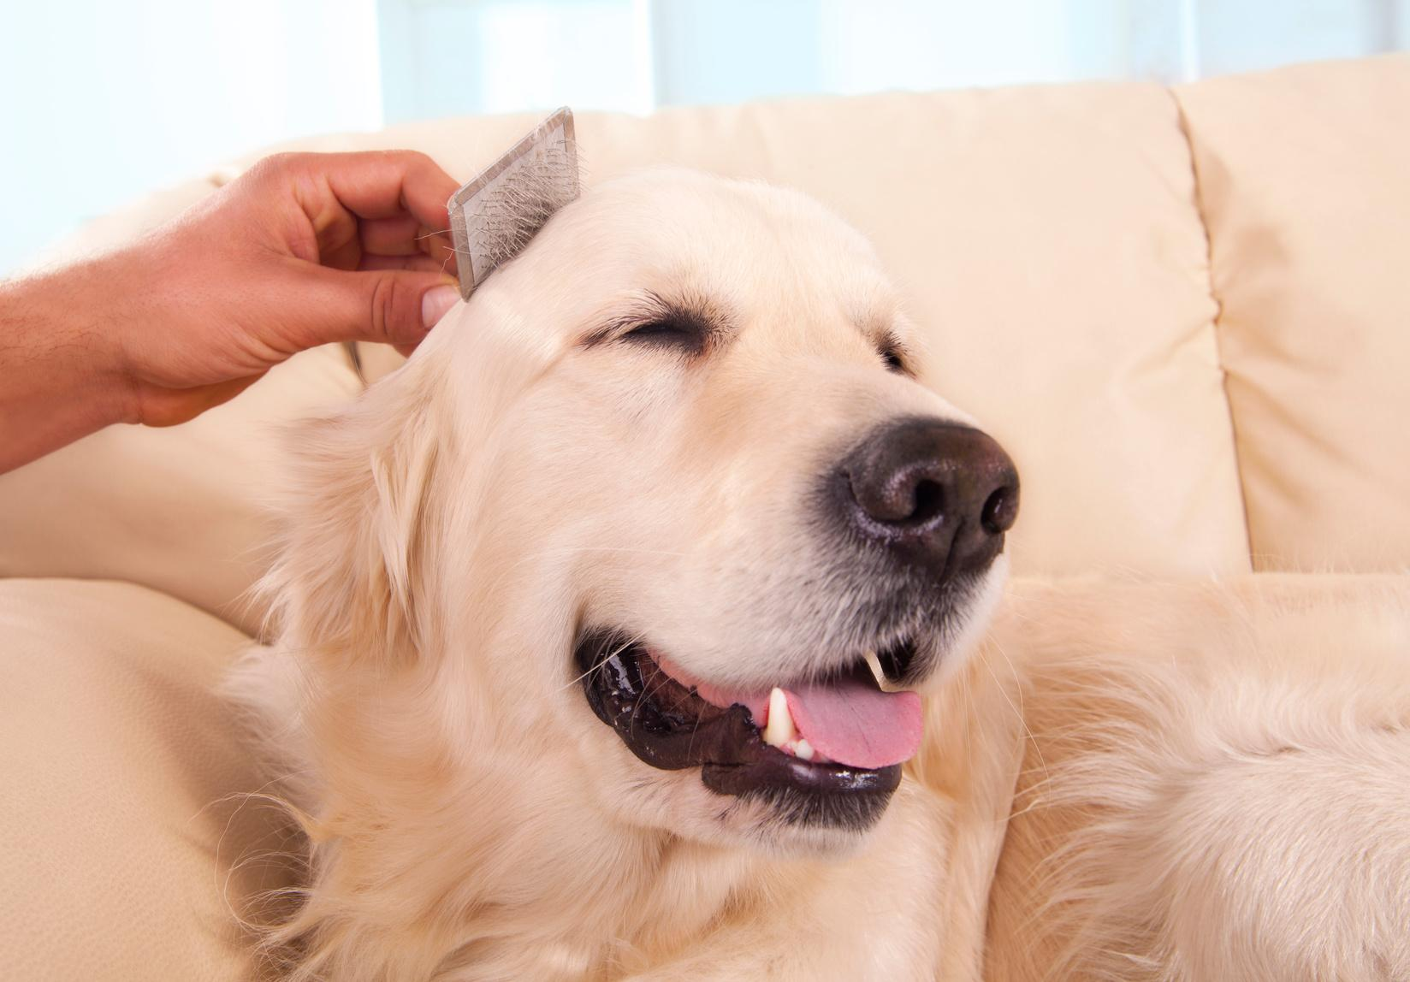
Best Model
VGG16
Input shape changed from 224 x 224 to 256 x 256
Kept layers frozen
Adam optimizer with learning rate = 0.0001
Weight Decay = 0.01
Sparse Categorical Cross Entropy
44M params, 14.7M trainable params
Acc : 86%

Slide 8
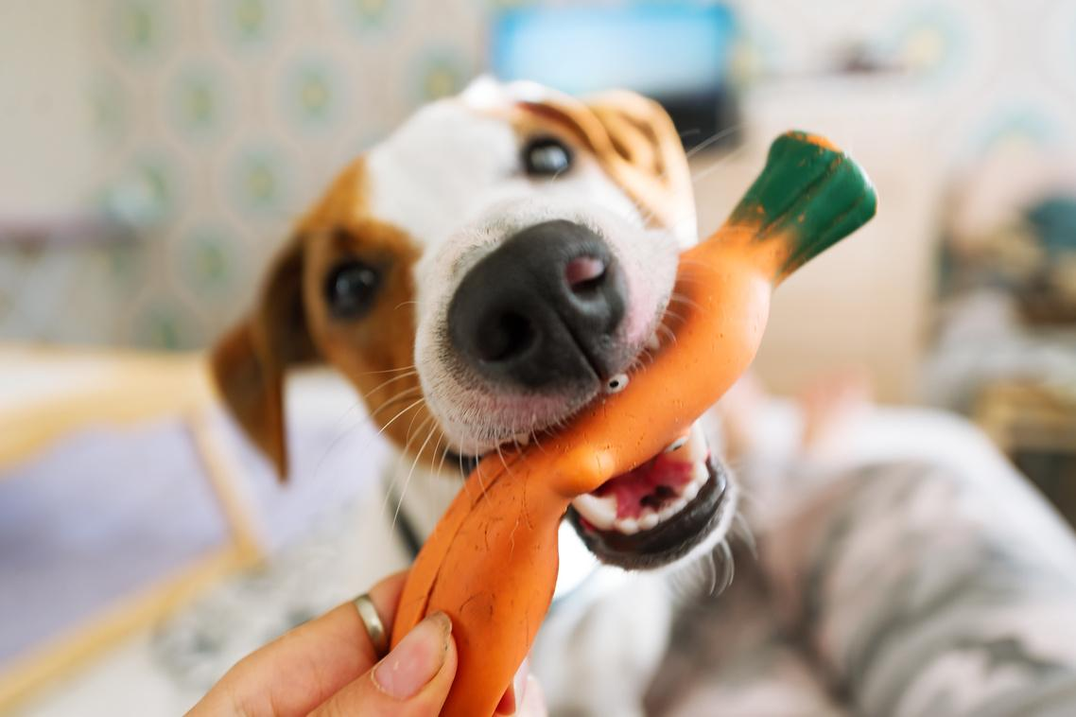

Limitations
I encountered an issue with newer versions of tensorflow (2.16.1 +) that prevented me from using model.summary() on VGG16 models
I also encountered a bug where I was unable to read in my saved model, even though it was able to be successfully read in and used in my streamlit app
The issue seems to be known across various channels but no good solutions are available yet beyond downgrading tensorflow to 2.15.0

Slide 9
Confusion Matrix
 | Predicted Angry | Predicted Happy | Predicted Sad | Predicted Relaxed
Actual Angry
Actual Happy
Actual Sad
Actual Relaxed

Slide 10


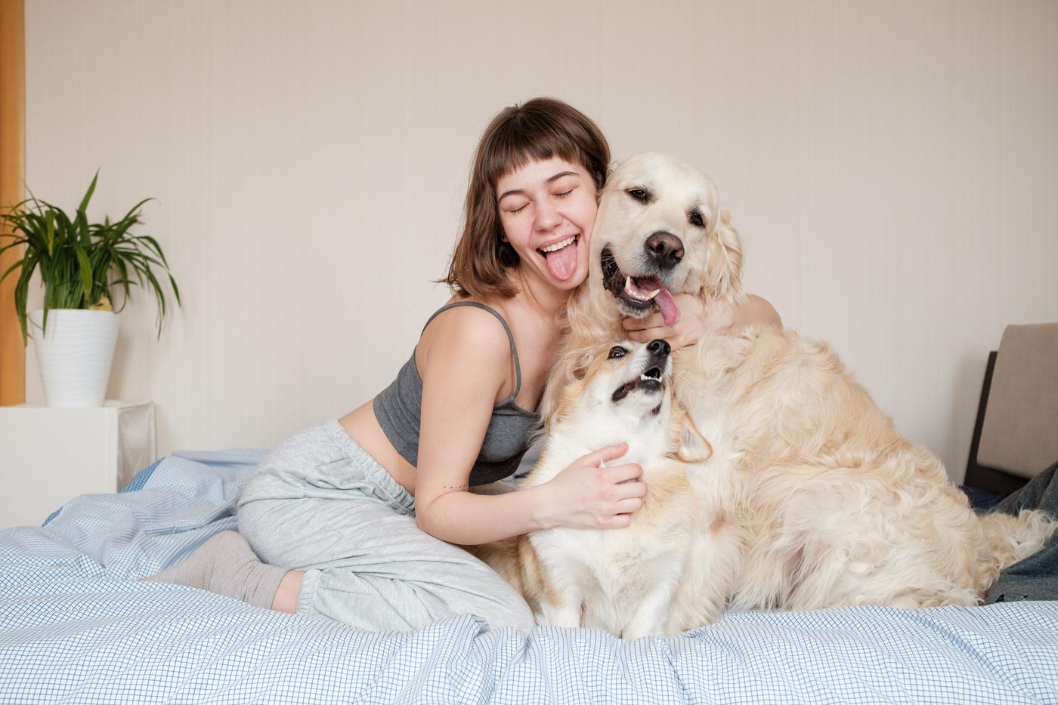
Streamlit App

Slide 11
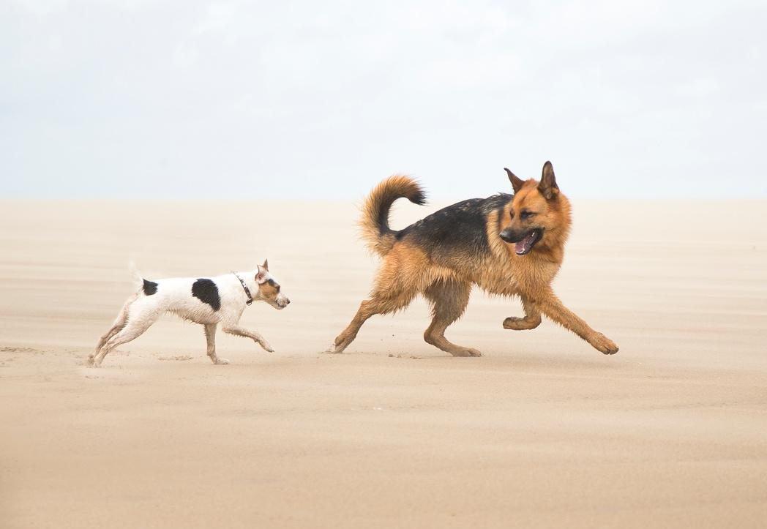
Conclusions
The best model in this scenario was a fairly basic VGG16 model
My model seems to struggle most with sad/relaxed photos
A larger dataset is likely necessary to further increase accuracy

Slide 12

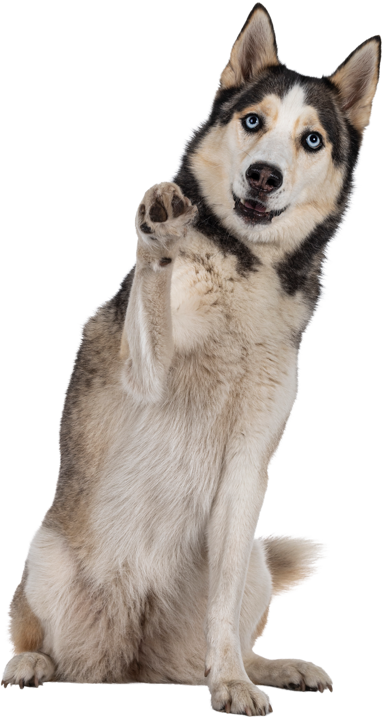

Next Steps
Collect more images
If I had more time to work on this project, some areas I’d like to focus on to potentially improve my model would be
Add other emotions
Try modifying VGG16 in other ways
Try to reduce overfitting
Try other pretrained models

Slide 13
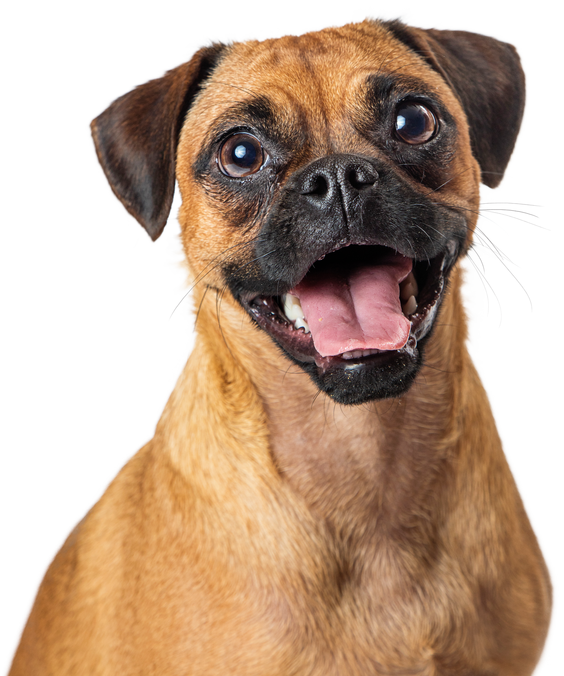
Resources
Kaggle Dataset: https://www.kaggle.com/datasets/danielshanbalico/dog-emotion/code
Streamlit:
https://streamlit.io/
Video on CNN models:
https://www.youtube.com/watch?v=jztwpsIzEGc&t=3543s
Special thanks to Rowan!

Slide 14
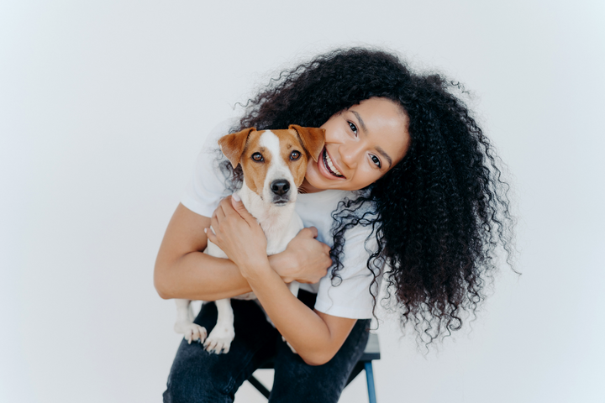


Questions?

